Slide 1
ASSIGNMENT 2 : 19AIE104 INTRODUCTION TO ELECTRICAL ENGINEERING
SUBMITTED BY TEAM 11
TEAM MEMBERS
VIKHYAT BANSAL [AIEA.1007359]
YARRAM SRI SATHWIK REDDY [AIEA.1038833]
VIGNESH M [AIEA. 1008496]
MAREDDY MOHIT SASANK REDDY [1011669]

Slide 2
CONTRIBUTION
YARRAM SRI SATHWIK REDDY
MAREDDY MOHIT SASANK REDDY
MAREDDY MOHIT SASANK REDDY
VIKHYAT BANSAL
VIGNESH M.

Slide 3

1.Using MATLAB/Python/Octave, plot a sinusoidal waveform with magnitude of 100 (rms) and frequency of 10 Hz.
Sol:
Given that,
RMS value of sine wave = 100
Frequency = 10Hz
Amplitude = rms*sqrt(2)
Now I'm using MATLAB to plot a sinusoidal waveform with
Given magnitude and frequency

Slide 4
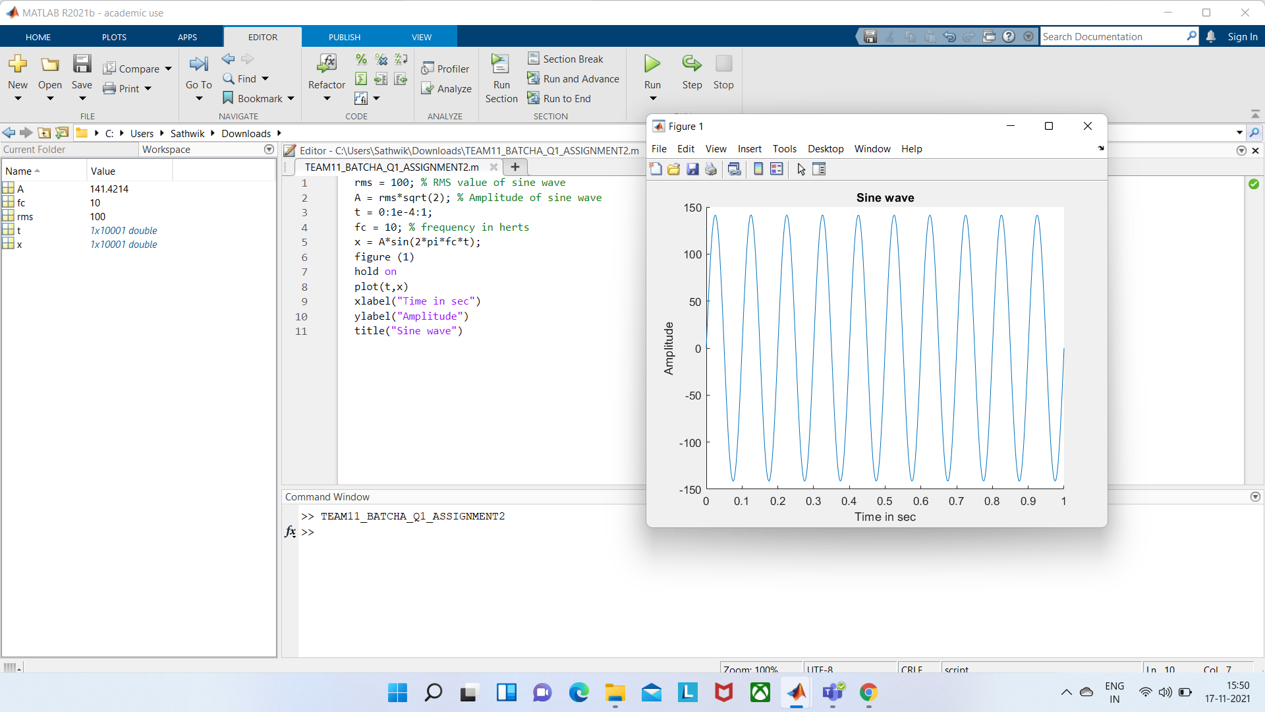

Slide 5
Graph:

Slide 6
Q2) Plot the sine wave in question 1 alongside another sine wave of half its magnitude and leading it by 30 degrees . Both waves should be in the same plot.
SOLUTION:
GIVEN,
RMS VALUE=100
FREQUENCY=10Hz (from question 1)
REQUIRED FORMULA:
Amplitude(a)= RMS * sqrt (2)

Slide 7
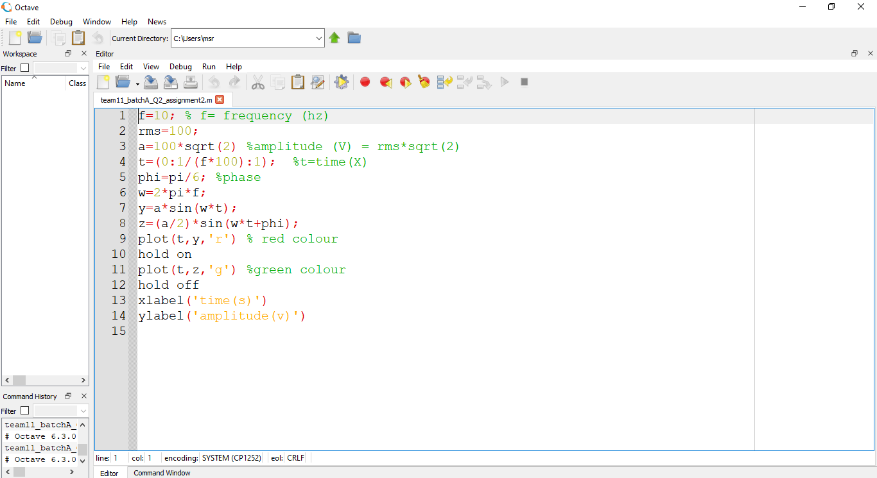
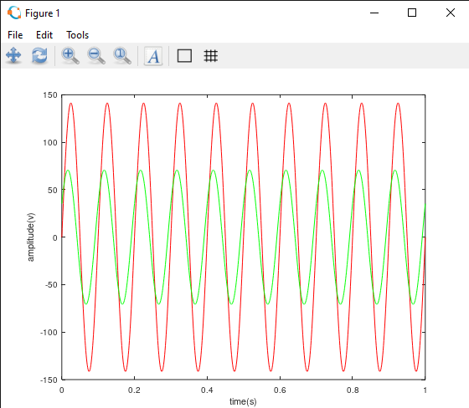
PLOTTING THE GRAPH USING OCTAVE:

Slide 9
Q3) Calculate the RMS and average values, and the form factor for the sine wave detailed in question no. 1.
SOLUTION:
GIVEN THAT, FORMULAE ,
Irms=100 Iavg=0.637Im
Im=Irms*(sqrt(2))
CALCULATION,
Im=Irms*sqrt(2)
=100*1.4142
=141.421
Im=141.421
Iavg=0.637*141.421
Iavg=90.085

Slide 10
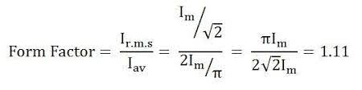
FORM FACTOR(Kf):
It is the ratio of r.m.s value to average value.
FORM FACTOR=Irms/Iavg
=100/90.085
=1.1100...
FORM FACTOR (Kf)=1.11

Slide 11
4. Calculate the RMS value and peak factor for a square wave of peak magnitude 100 and 25 Hz.
What is rms value , Is rms value same for all and How to derive rms value for square wave?
In mathematics and its applications, the root mean square (RMS or rms or rms) is defined as the square root of the mean square (the arithmetic mean of the squares of a set of numbers).The RMS is also known as the quadratic mean and is a particular case of the generalized mean with exponent 2. RMS can also be defined for a continuously varying function in terms of an integral of the squares of the instantaneous values during a cycle.
For alternating electric current, RMS is equal to the value of the constant direct current that would produce the same power dissipation in a resistive load.
In estimation theory, the root-mean-square deviation of an estimator is a measure of the imperfection of the fit of the estimator to the data.
The RMS value of a set of values (or a continuous-time waveform) is the square root of the arithmetic mean of the squares of the values, or the square of the function that defines the continuous waveform. In physics, the RMS current value can also be defined as the "value of the direct current that dissipates the same power in a resistor."

Slide 12
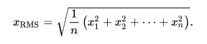
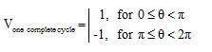
From above definition it is pretty clear that RMS value is not same for different waveforms so we will now calculate RMS value for square waveform ,
When plotted as voltage (V) as a function of phase (θ), a square wave looks similar to the figure to the right. The waveform repeats every 2π radians (360°), and is symmetrical about the voltage axis (when no DC offset is present). Voltage and current exhibiting cyclic behavior is referred to as alternating; i.e., alternating current (AC). One full cycle is shown here. The basic equation for a square wave is as follows:
Root-Mean-Square Voltage (V _{rms})
As the name implies, V _{rms} is calculated by taking the square root of the mean average of the square of the voltage in an appropriately chosen interval. In the case of symmetrical waveforms like the square wave, a quarter cycle faithfully represents all four quarter cycles of the waveform. Therefore, it is acceptable to choose the first quarter cycle, which goes from 0 radians (0°) through π/2 radians (90°).

Slide 13
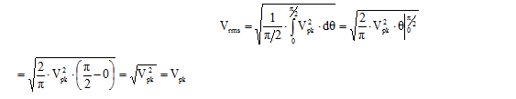
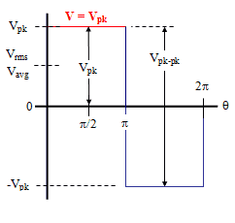
V _{rms} is the value indicated by the vast majority of AC voltmeters. It is the value that, when applied across a resistance, produces that same amount of heat that a direct current (DC) voltage of the same magnitude would produce. For example, 1 V applied across a 1 Ω resistor produces 1 W of heat. A 1 V _{rms} square wave applied across a 1 Ω resistor also produces 1 W of heat. That 1 V _{rms} square wave has a peak voltage of 1 V.
DERIVATION OF RMS VALUE FOR SQUARE WAVE
So V _{pk} = V _{rms}

Slide 14
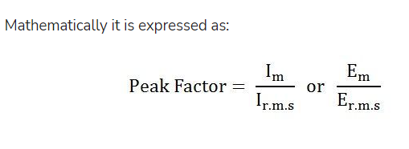
WHAT IS PEAK FACTOR?
Definition:
Peak Factor is defined as the ratio of maximum value to the R.M.S value of an alternating quantity. The alternating quantities can be voltage or current. The maximum value is the peak value or the crest value or the amplitude of the voltage or current.
Where, I _{m} and E _{m} are the maximum value of the current and the voltage respectively, and I _{rms} and E _{rms} are the roots mean square value of the alternating current and the voltage respectively.

Slide 15
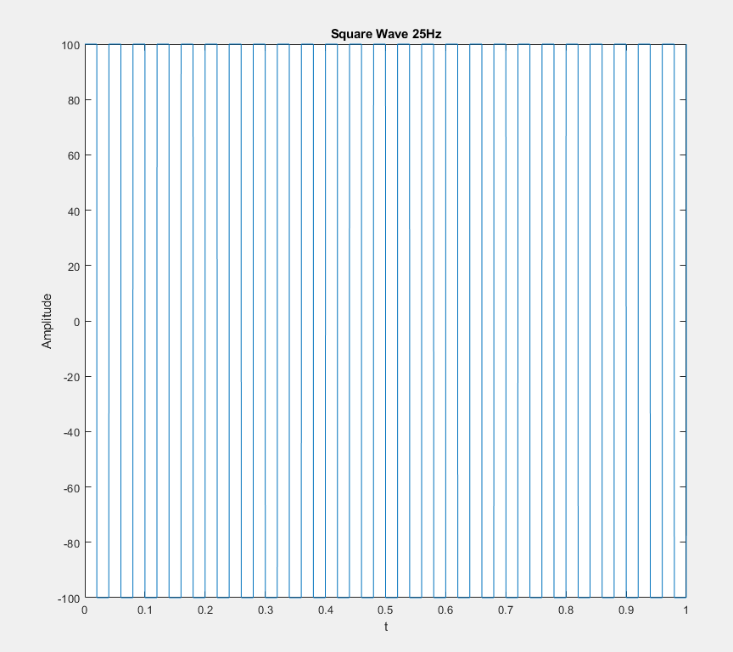
In the question it is asked that what is rms and peak factor for square wave;
Amplitude(Peak Voltage) = 100
Frequency = 25
Now from above theory we have derived that in Square Wave V _{PK} = V _{RMS}
So V _{RMS} = 100
For Peak Factor,
From definition we know that;
V _{PK}/V _{RMS} = Peak Factor
100/100 = 1
So Peak Factor = 1

Slide 16
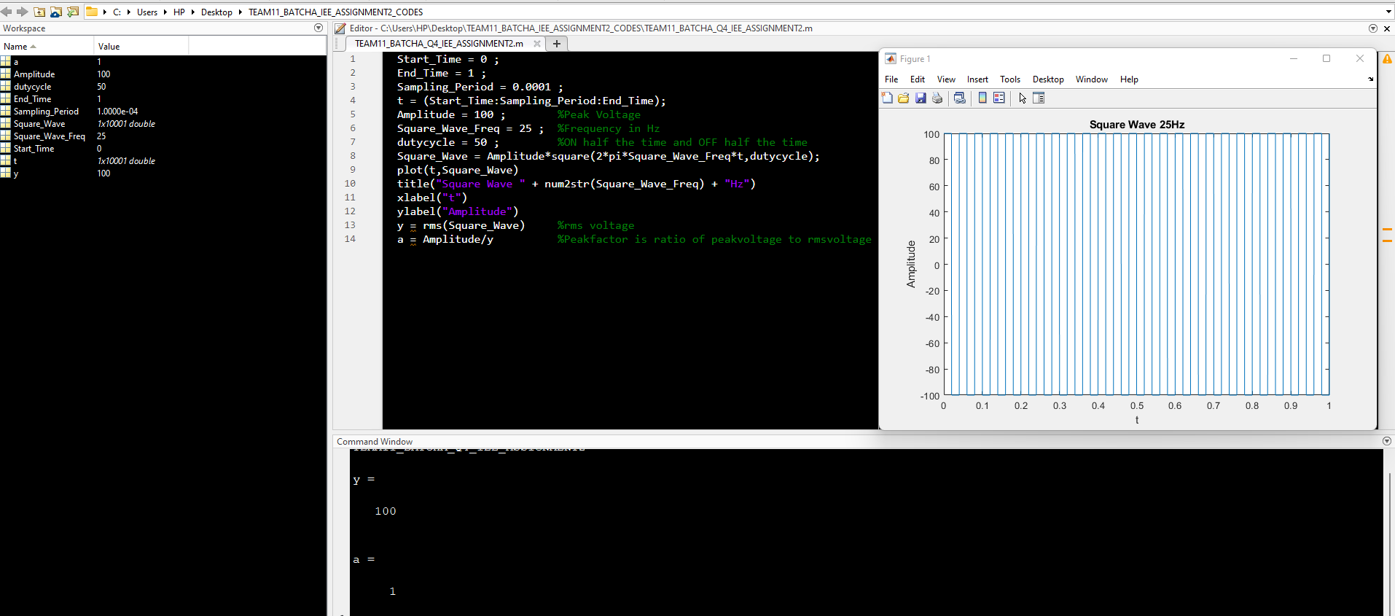

Slide 17
5.Calculate the RMS value and form factor for a symmetrical triangular wave of peak magnitude 100 and 25 Hz.
Sol:
Root mean square or R.M.S. value of Alternating current is defined as that value of steady current, which would generate the same amount of heat in each resistance is given time, as is done by A.C. current , when maintained across the same resistance for the same time.
Given that,
Amplitude = 100
Frequency = 25Hz
We know that for symmetrical triangular wave,
RMS value = 1/sqrt(3)*Amplitude
= 100/sqrt(3)
= 57.73

Slide 18
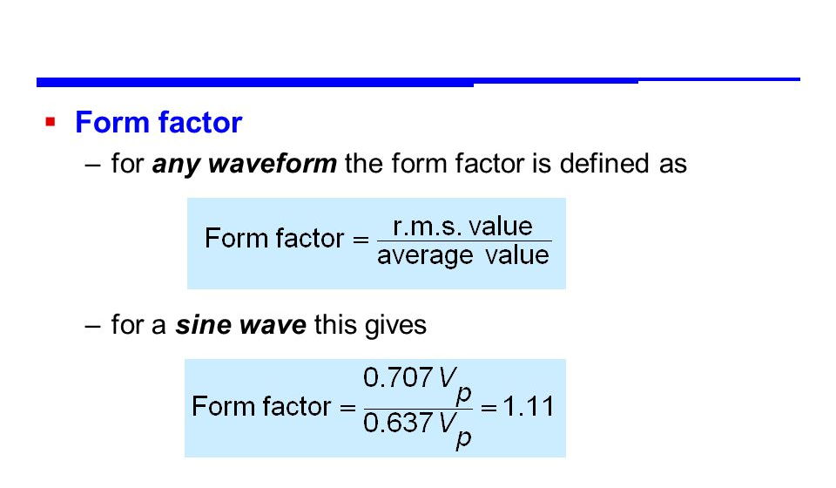
Average value = ½*Amplitude
= ½*100
= 50
Formfactor = RMS value
---------------
Average value
= 57.73/50
= 1.155

Slide 19
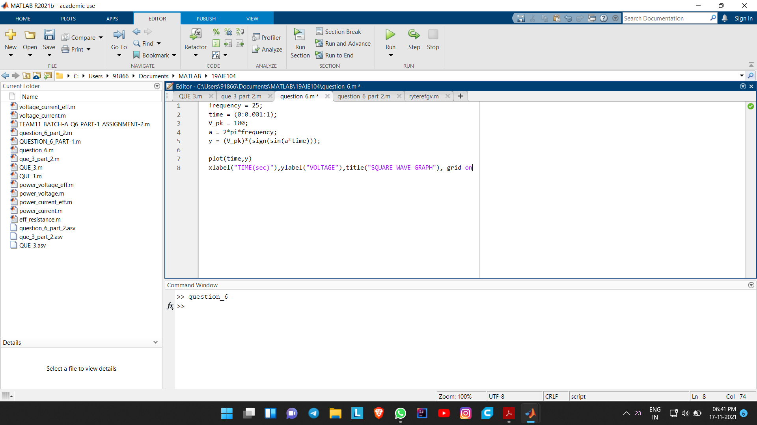
6) Using MATLAB/Python/Octave plot the signal mentioned in questions 4 and 5 with and without the help of built-in functions.
SQUARE WAVE FORM SIGNAL (with build in function)

Slide 20
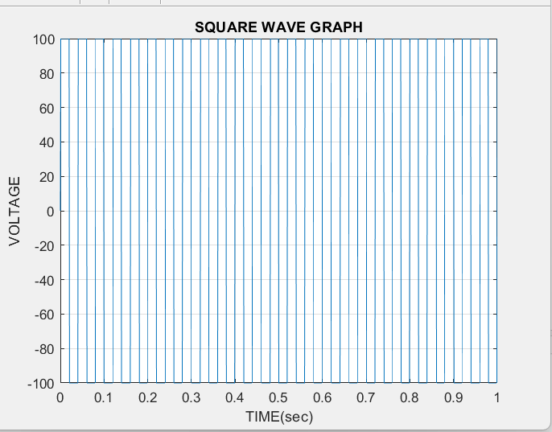

Slide 21
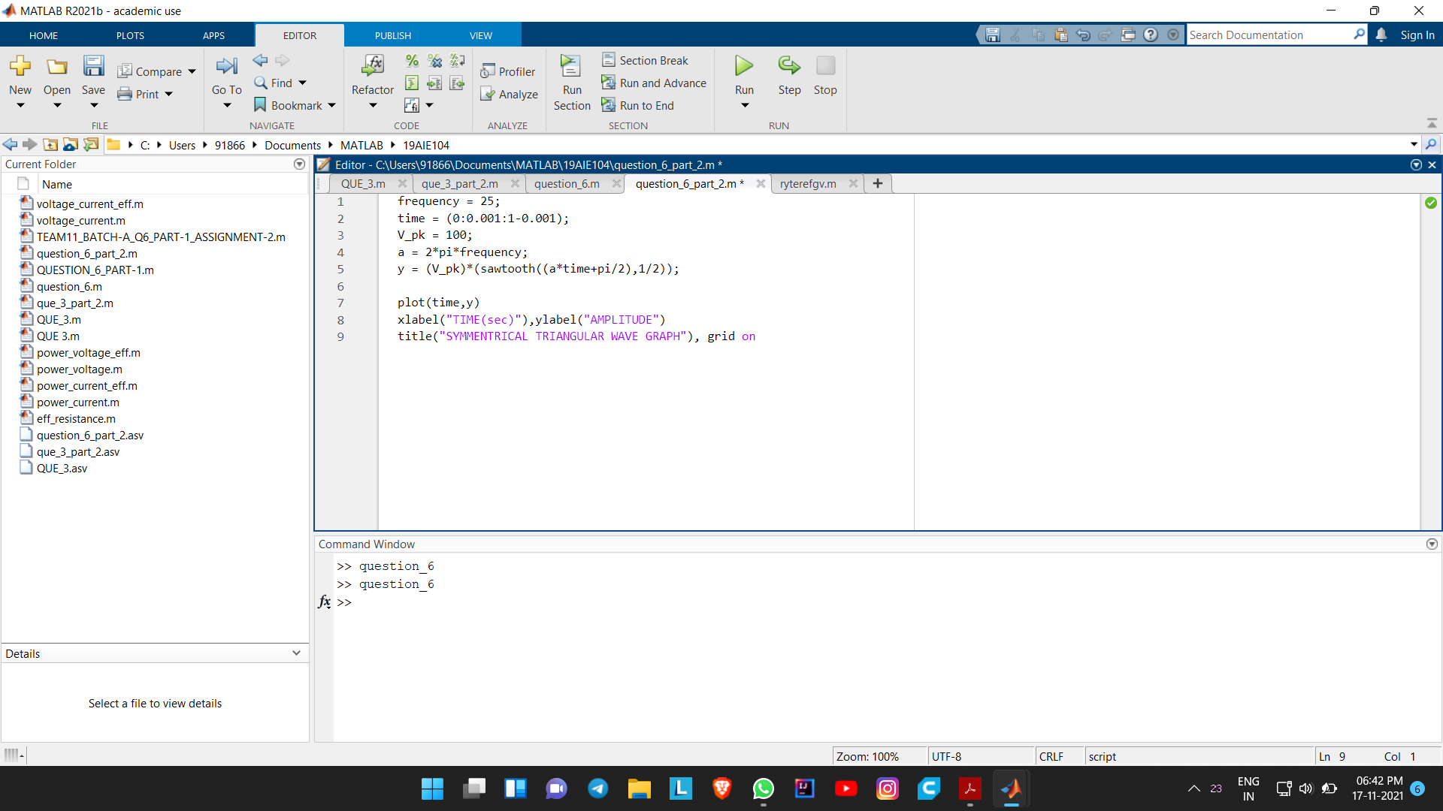
TRIANGULAR WAVE FORM SIGNAL (with build-in functions)

Slide 22
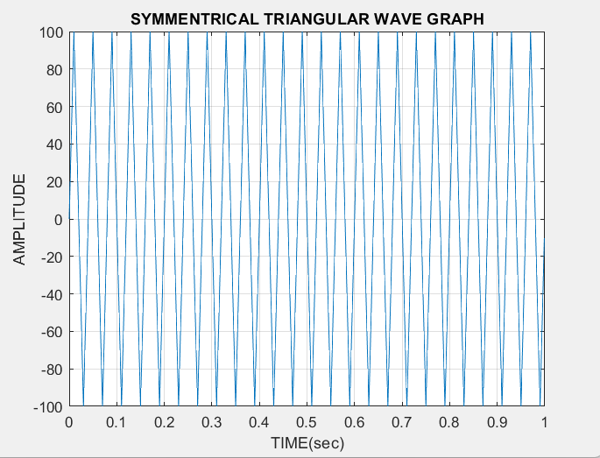

Slide 23
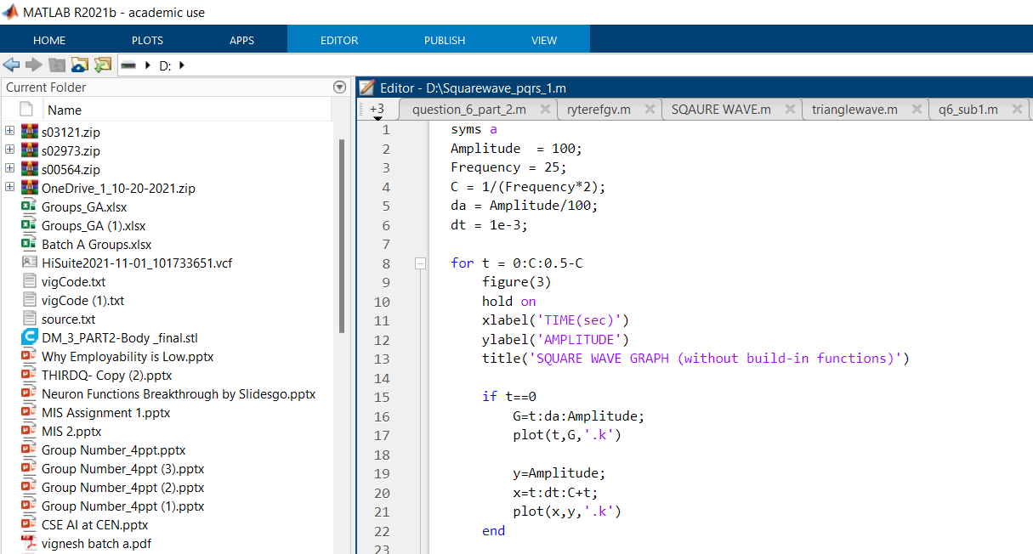
SQUARE WAVE FORM SIGNAL (without build in functions)

Slide 24
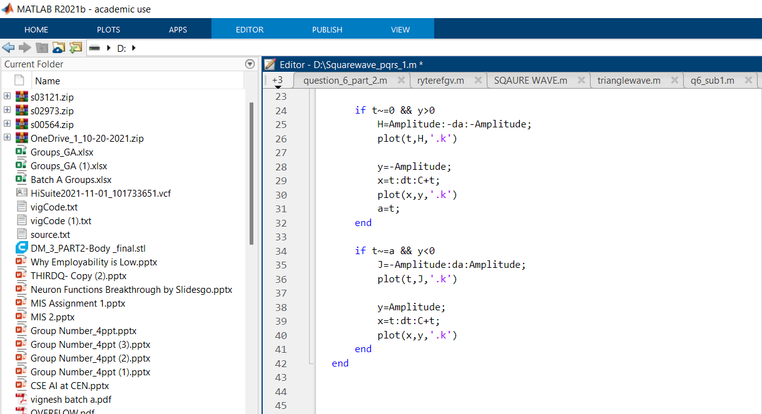

Slide 25
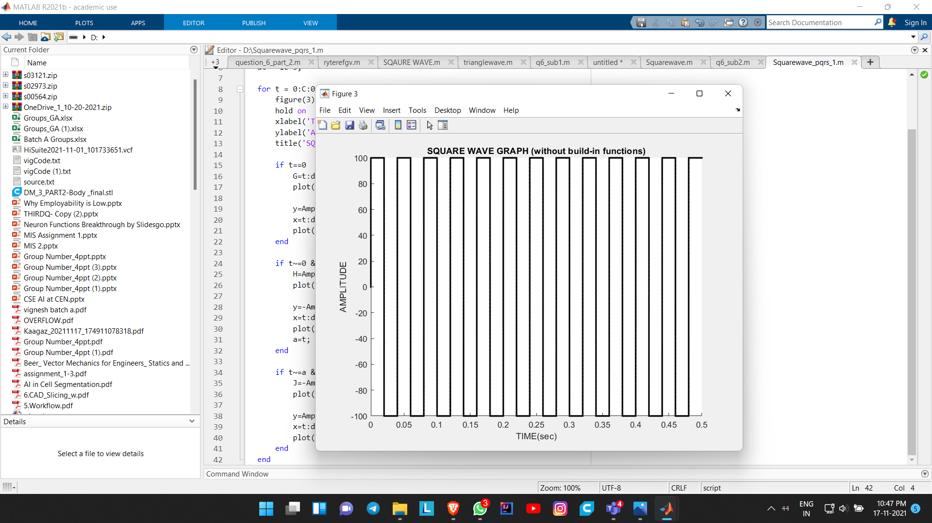

Slide 26
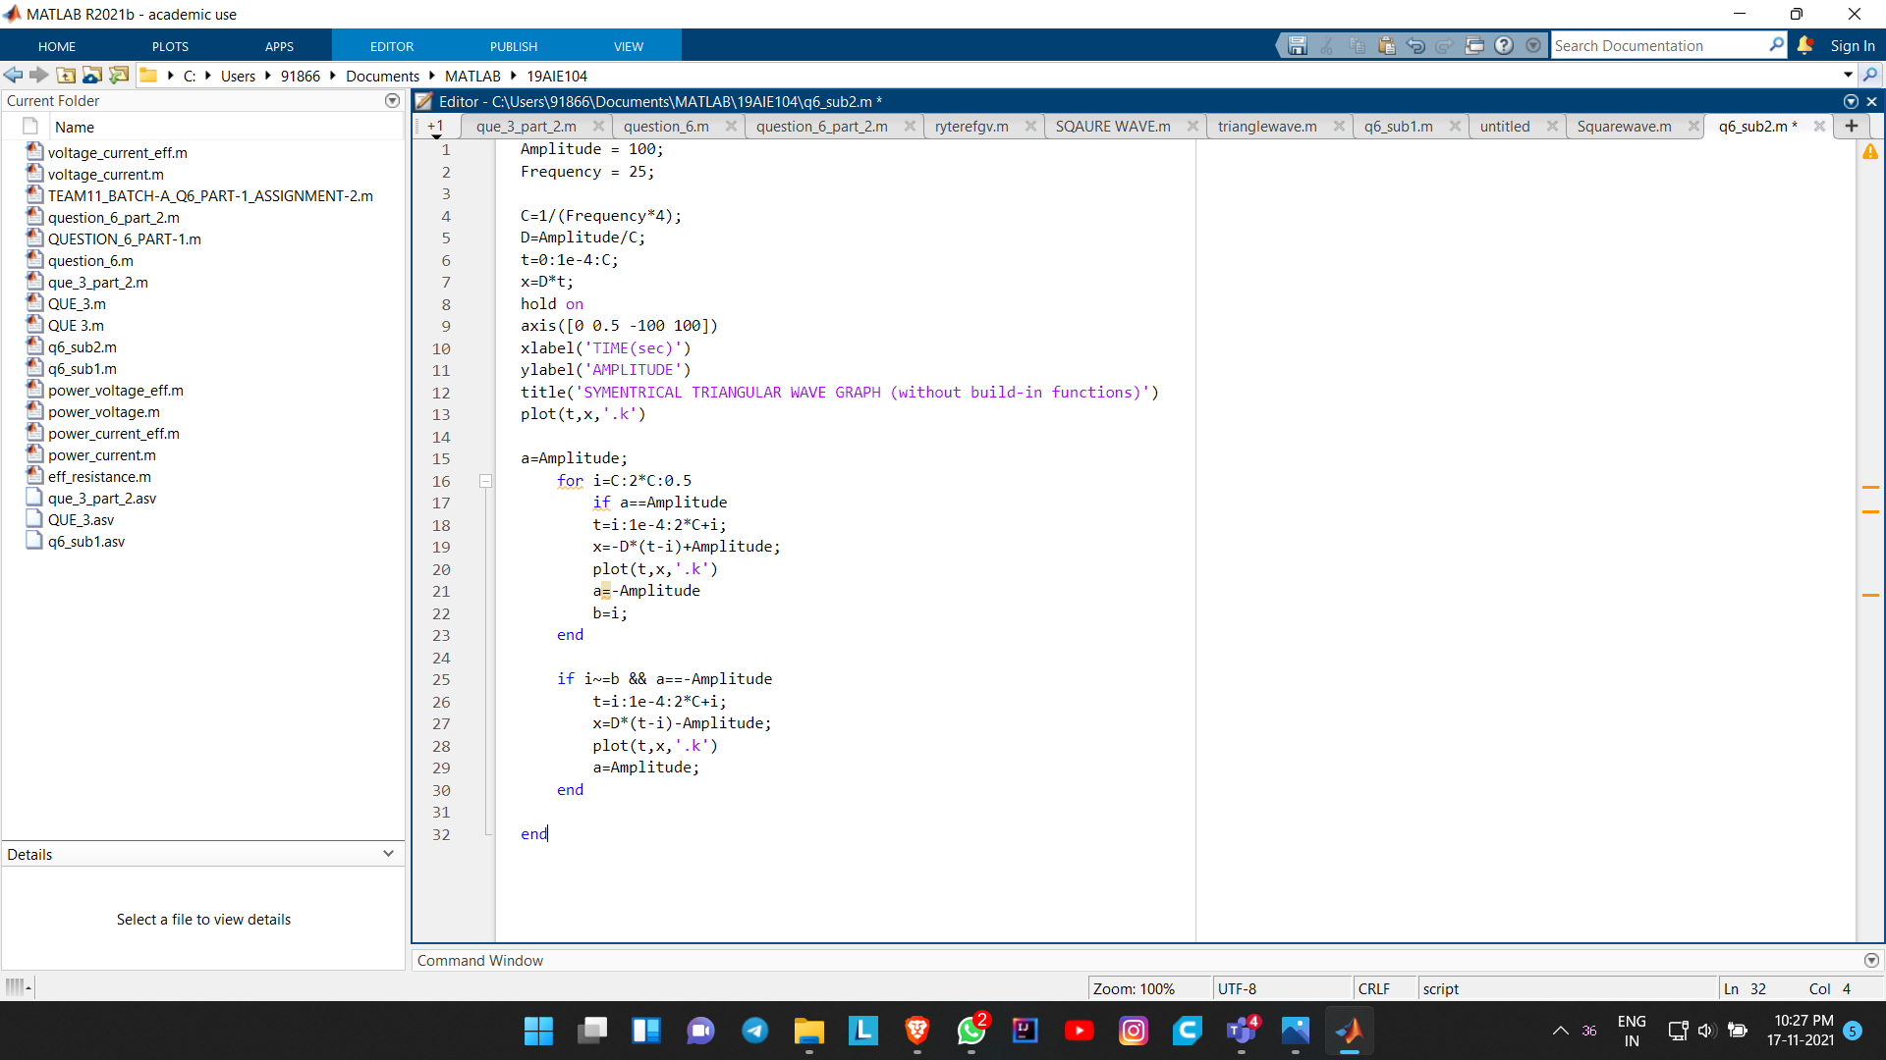
TRIANGULAR WAVE FORM SIGNAL (without using build-in functions)

Slide 27
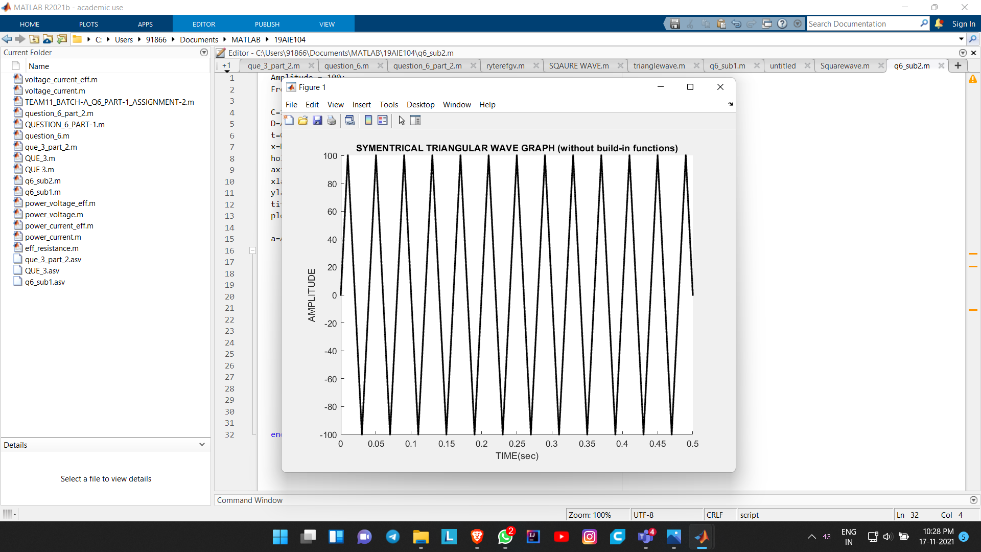

Slide 28
THANK YOU!!

